Slide 1

IBM SkillsBuild for Adult Learners - Data Analytics
Data Analytics Internship Program 2024 Final Project Presentation
Project Name : Inclusive Education For All
Unique ID :IBM3043 Team Name :Cannabi Coders
College Name :Odisha University of Education and Research

Slide 2




TEAM MEMBERS
SPANDAN CHOUDHURY
(LEADER)
PRATYUSH PRIYABRATA MISHRA
DURGA MADHAB DAS
SATYAJIT MISHRA

Slide 3
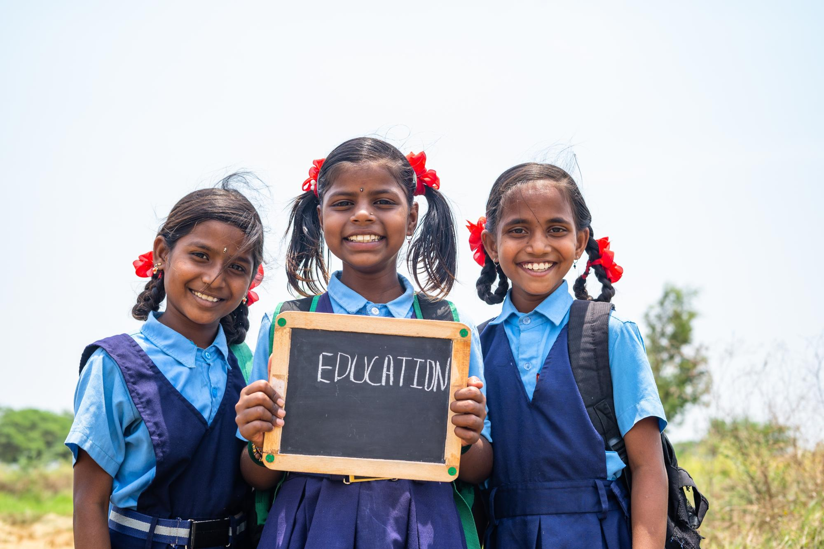

INTRODUCTION
The dropout rate refers to the percentage of students who leave a specific educational program or institution before completing it.
This metric is used to assess the effectiveness of educational systems and programs, as well as to identify potential issues that may be causing students to disengage or leave school prematurely.
This project aims to analyse School Dropout Rate data to understand the trends and possible factors leading to the same.
By leveraging data analysis tools and methodologies, the project seeks to propose actionable solutions that align with Sustainable Development Goal 4 (SDG 4): Quality Education
The primary objective of this project is to analyse school dropout data to identify the major sources and trends of educational exclusion and to propose data-driven solutions that can help reduce the higher drop-out rates

Slide 4

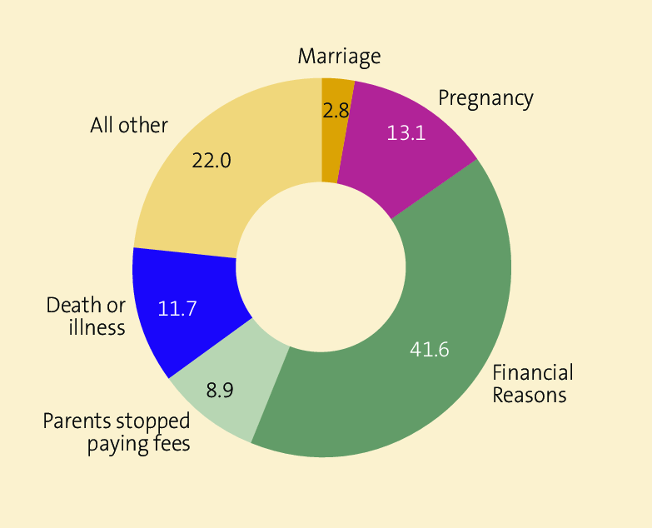
INTRODUCTION
OBJECTIVE
To collect and analyse school dropout data from reliable sources.
To identify the primary reasons of academic negligence in women and specific in each states.
To understand the temporal and spatial trends of refined data.
To propose actionable solutions and policy recommendations to mitigate Educational Exclusion.
To assess the potential impact of these solutions on achieving SDG 4.

Slide 5
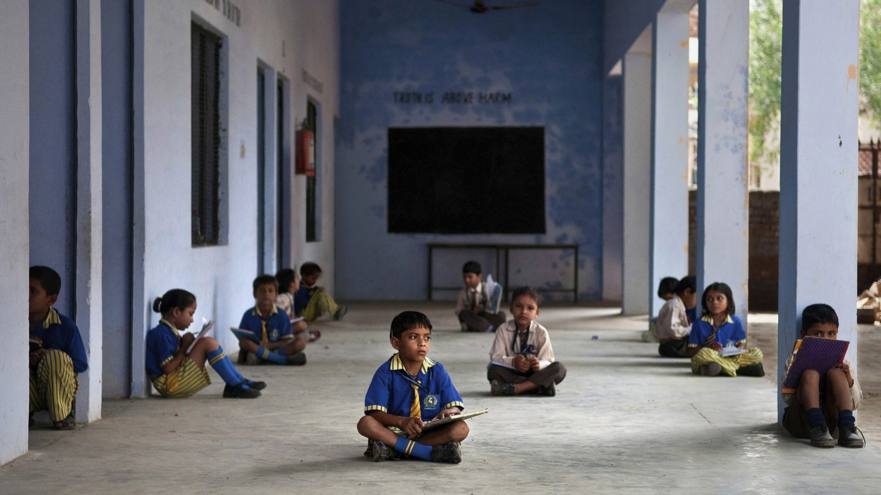
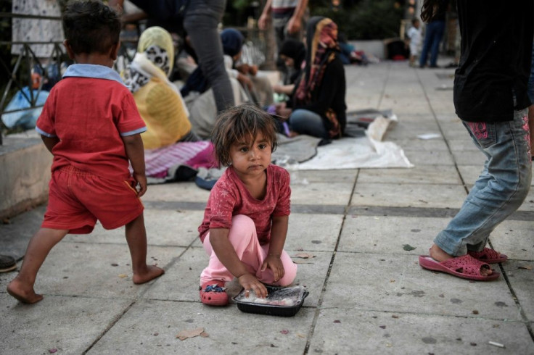
PROBLEM IDENTIFICATION
PROBLEM STATEMENT
Higher drop out rates at the secondary level in some states of india.Unable to control the drop out population due to unavaibility of data and ineffective policy implementation.The project henceforth aims to reduce drop-out rate by implement specific practical solutions for women ,children of various classes etc.
SIGNIFICANCE OF THE PROBLEM
Children in remote areas unable to avail proper education due to poor infrastructure and lack of basic amenities.
Limited work potential, increased crime rates,strained socail safety nets all of these are directly linked to dropout population.
This data depicts academic negligence amongst women and specific froups in each state.
RELEVANT SDGS
Quality Education. This SDG aims to ensure inclusive and equitable quality education and promote lifelong learning opportunities for all.

Slide 6


DATA COLLECTION
DATA SOURCES
Education For All in India: Dropout Rates in Schools in India: An Analysis of UDISE+ 2021-22 Data.( https://educationforallinindia.com/dropout-rates-in-schools-in-india)
Open Government Data (OGD) Platform India (https://data.gov.in/catalog/dropout-rate)
Statistica : Average Annual drop-outs in schools in India . (https://www.statista.com/statistics/661218/average-annual-drop-outs-in-schools-india)
DATA DESCRIPTION
The datasets included in the project focus on Drop-out Rates in various states amongst various Levels of education for both genders.
Datasets accounting for the Drop-out rates in the recent decade has also been analysed.
DATA COLLECTION METHODS
surveys, interviews, observations, focus groups, experiments, and secondary data analysis

Slide 7




DATA PREPROCESSING
Data was cleaned using Python to address the following issues :
Duplicate records
Inaccurate data
Missing or incomplete data
Inconsistent data
Sorting Techniques were implemented to get the Data in desired order for better analysis.
Google collab was used for data manipulation and developing predictive models.
Filtering was done in State wise dataset to find the hotpots for spatial analysis.
Ms.Excel and Matplotlib were used for visualization.

Slide 8
DATA PREPROCESSING
A glimpse of cleaned and processed data has been shown
Column1 | Column2 | Column3 | Column4 | Column5 | Column6 | Column7 | Column8 | Column9 | Column10
India/State/UT | Primary (1 to 5) |  |  | Upper Primary (6-8) |  |  | Secondary (9-10)
0 | Boys(pri) | Girls(pri) | Total(pri) | Boys(UP) | Girls(UP) | Total(UP) | Boys(sec.) | Girls(sec) | Total(Sec)
India | 1.6 | 1.4 | 1.5 | 2.7 | 3.3 | 3 | 13 | 12.3 | 12.6
Andaman and Nicobar Islands | 0.2 | 0.7 | 0.4 | 0.9 | 1 | 1 | 6 | 3.9 | 5
Andhra Pradesh | 0 | 0 | 0 | 1.7 | 1.5 | 1.6 | 17.5 | 15 | 16.3
Arunachal Pradesh | 9.3 | 9.2 | 9.3 | 4.8 | 8.4 | 6.7 | 11.2 | 12.3 | 11.7
Assam | 6.8 | 5.2 | 6 | 10.1 | 7.6 | 8.8 | 19.8 | 20.7 | 20.3
Bihar | 0 | 0 | 0 | 4 | 5.2 | 4.6 | 19.5 | 21.4 | 20.5
Chandigarh | 0 | 0 | 0 | 0 | 0 | 0 | 0 | 0 | 0
Chhattisgarh | 1 | 0.6 | 0.8 | 4.8 | 3.3 | 4.1 | 11.5 | 8.1 | 9.7
Dadra and Nagar Haveli & Daman & Diu | 0 | 0 | 0 | 0 | 0 | 0 | 10.5 | 8.4 | 9.5
Delhi | 0 | 0 | 0 | 0 | 0 | 0 | 5.9 | 3.7 | 4.8
Goa | 0 | 0 | 0 | 0 | 0 | 0 | 12.1 | 5.5 | 9
Gujarat | 0 | 0 | 0 | 4.2 | 5.8 | 5 | 19.4 | 15.9 | 17.9
 | Primary Drop Out Rate |  |  | Upper Primary Drop Out Rate |  |  | Secondary Drop Out Rate
Year | Girls(Pri) | Boys(Pri) | Overall(Pri) | Girls(UP) | Boys(UP) | Overall(UP) | Girls(Sec) | Boys(Sec) | Overall(Sec)
2012-13 | 4.66 | 4.68 | 4.67 | 4.01 | 2.3 | 3.13 | 14.54 | 14.54 | 14.54
2013-14 | 4.14 | 4.53 | 4.34 | 4.49 | 3.09 | 3.77 | 17.79 | 17.93 | 17.86
2014-15 | 3.88 | 4.36 | 4.13 | 4.6 | 3.49 | 4.03 | 16.88 | 17.21 | 17.06
2015-16 | 1.35 | 1.55 | 1.45 | 3.31 | 2.74 | 3.02 | 12.25 | 12.96 | 12.61
2016-17 | 6.3 | 6.4 | 6.35 | 6.42 | 4.97 | 5.68 | 22.15 | 22.11 | 22.13
2017-18 | 3.33 | 3.68 | 3.51 | 5.57 | 4.49 | 5.02 | 18.66 | 19.16 | 18.93
2018-19 | 4.3 | 4.59 | 4.45 | 5.14 | 4.26 | 4.68 | 17.05 | 18.68 | 17.9
2019-20 | 1.24 | 1.7 | 1.48 | 2.98 | 2.24 | 2.6 | 15.07 | 17.02 | 16.09
2020-21 | 0.69 | 0.83 | 0.76 | 2.61 | 1.95 | 2.27 | 13.71 | 14.34 | 14.04
2021-22 | 1.6 | 1.4 | 1.5 | 2.7 | 3.3 | 3 | 13 | 12.3 | 12.6

Slide 9
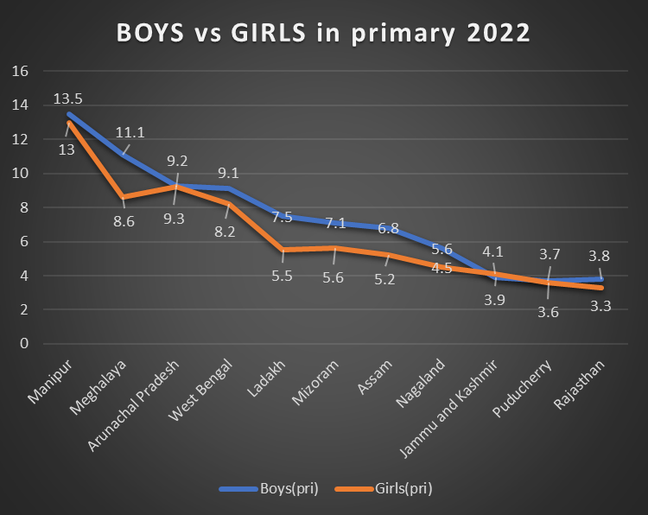
DATA ANALYSIS(As per the most recent government data for the year 2022)
Primary Education
On the left the graph depicts the top 10 states having Primary Drop out rates more than the national average. Manipur, Meghalaya, Arunachal Pradesh are among the states having highest rate of primary Drop out rates.
On the right, we can observe that, for Drop out rates at the Primary level of education, the Drop out rates for Boys was always higher than the Girls for the above states with the highest Drop out rate.

Slide 10
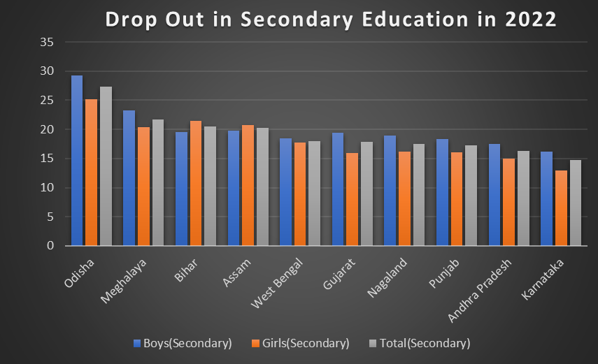
DATA ANALYSIS
Upper-Primary & Secondary education
The above analysis shows visualisation of Drop out rates in Upper-Primary and Secondary level of education.
The above graphs on the left and right depict the states with highest amount of Drop out rates in the Primary and Secondary level of education respectively.
Further by comparing and visualising the above two graphs we can conclude the Drop out rates in the Secondary level of education is far higher than that in Primary level of education and Meghalaya is among the states with highest Drop out rates irrespective of any level of education.

Slide 11
Data Analysis(Recent Decade)
The above graphs depicts the Drop out rates of Boys compared with to that of Girls.
At Primary level, the Drop out rates of Boys and Girls was fairly equal with DOR slightly higher in boys.
At Upper Primary level, the Drop out rates in Girls was quite higher than that of the Boys(until 2021-22 where the DOR for Boys was higher).
At Secondary level, the Drop out rates in Boys and Girls were mostly equal until after 2017-18 were the DOR in boys was higher in the corresponding years.
Cumulatively, it was observed that the Drop out rates in Secondary level in both Boys and Girls were far higher than that in Primary and Upper Primary with a mean DOR of 14.54.

Slide 12
HYPOTHESIS DEVELOPMENT
FORMULATED HYPOTHESIS
The hypothesis of the project is that by analysing school dropout rate data, we can identify key factors that contribute to educational exclusion.
This will allow us to develop targeted interventions that address these factors and ultimately reduce dropout rates and promote educational inclusion.
This hypothesis suggests that there's a connection between specific factors found in the data (e.g., socioeconomic background, dropouts in different level of education which can be primary secondary etc, location) and the likelihood of a student dropping out.
RATIONALE BEHIND HYPOTHESIS
By understanding these connections, we can bring changes like tutoring programs, financial aid, strict regulatory commissions (to check for child labour), targeted Government schemes etc., that addresses these root causes and keep students engaged in school.
Also, by studying the Data available we can predict the Dropouts in specific backgrounds, remote locations etc. and provide predictive analysis that will be vital to predict and reduce dropouts in the targeted regions with higher dropout rates.
Additionally, specific temporal and spatial trends in School dropout rates can be identified and addressed effectively.

Slide 13
HYPOTHESIS DEVELOPMENT
METHODS OF TESTING HYPOTHESIS
Data Collection:
Gather school dropout data from the above-mentioned sources.
Compile supplementary data to support the analysis.
Exploratory Data Analysis (EDA):
Perform descriptive statistical analysis to understand the school dropout rates among various communities, state.
Source Identification :
Use correlation analysis and regression models to identify communities at a potential risk of school dropout
Analyse impact of various factors like household income and communities most affected by dropouts.
Solution Development:
Based on the analysis, propose solutions such as implementing policies and pouring government resource at places which are more affected.
Assess the feasibility and potential impact of these solutions.
Reporting and Presentation:
Compile the findings into a comprehensive report.
Develop policy briefs and recommendations for stakeholders (including Government).

Slide 14


SOLUTION DESIGN
AMONG PRIMARY SCHOOLS
Develop and enforce laws that set a minimum age for employment and restrict hazardous work for minors. Ensure these laws are in line with international standards, such as those set by the International Labour Organization (ILO).
Increase the frequency of inspections in industries where child labor is prevalent and impose strict penalties on those who violate labor laws.
AMONG UPPER PRIMARY SCHOOLS
Ensure that laws setting a minimum age for marriage are strictly enforced and aligned with international standards (e.g., 18 years old).
Close legal loopholes that allow exceptions or parental consent to override minimum age requirements, implement and enforce strict penalties for individuals and institutions involved in facilitating child marriages.
AMONG SECONDARY SCHOOLS
Ensure consistent enforcement of policies and consequences for drug use, while also providing support and rehabilitation options.
Teach students decision-making and problem-solving skills to help them resist peer pressure and make healthy choices.
Implementation Plan
Alignment with SDGs

Slide 15
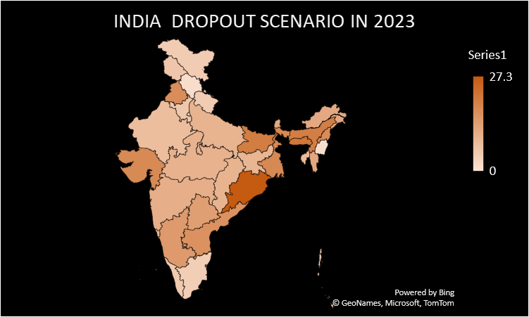
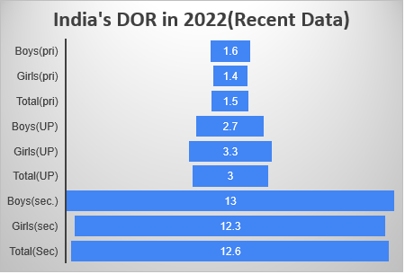
VISUALIZATION
The above graph on the left shows the comparison of India’s Drop out rate across the various level of education that comprise of Primary, Upper Primary, and Secondary for Boys, Girls and Total respectively in 2022. With the help of the above graph we can conclude that the DOR is highest at the secondary level of education with a Total DOR of 12.6%.
On the right, we can observe a Heat map that scales the states having a concerning DOR that are coloured darker. From this heat map we can observe that states like Odisha, Bihar, Assam, Meghalaya are among those states where the DOR is alarmingly high.

Slide 16
VISUALIZATION
The above graph depicts the Overall Drop out rate in the last Decade(2012-22).
By visualising the above Data we can analyse that the 2016 was the year with highest number(22.13%) of students Dropping out at any level of education in the country thus labelling 2016 the year with highest Drop out rate in the past decade.

Slide 17
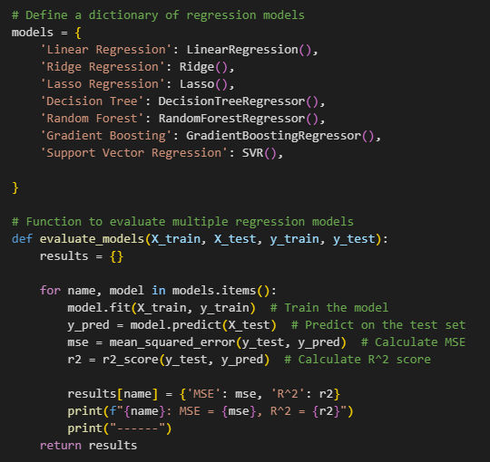
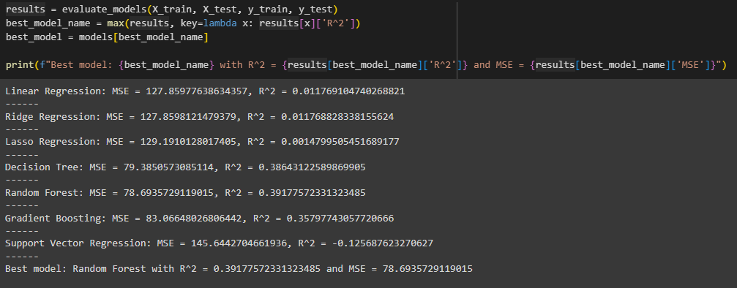
TRAINING A REGRESSION PREDICTION MODEL OF DROPOUT RATE
Now we use our data and machine learning to predict how drop out rates will be affected depending upon the sources like location
Determination of the best model to fit
We first list all the various types of regression models we will check.
Then we train each of the models on a splitted training data and evaluate the R^2 score and mse of each model using the testing data storing all in a list
Then we select the best model and see its R^2 and mse
In our case it was found to be Random Forest regression with R^2 = 0.386 and MSE = 79.378

Slide 18
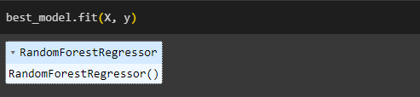
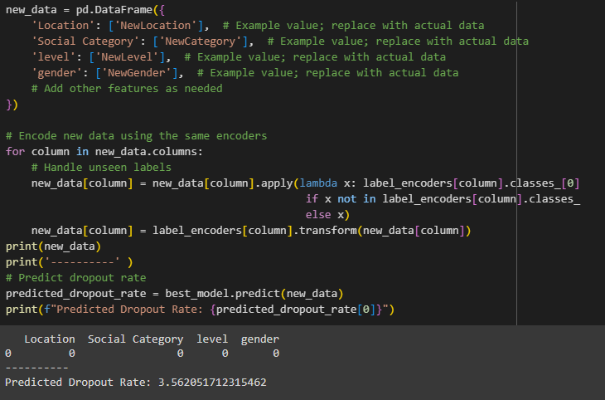
PREDICTION
In this part we use the model for prediction.
Retraining
We again train the best model on the entire data set so we get more accurate predictions .
Prediction
We then give example values of location, social class, level of education(i.e. primary, upper primary, secondary) and gender to predict the dropout rate.
In the taken example we find the estimated dropout rate to be 3.562.
*NB* (For detailed predictive analysis please refer the notebook.)
https://colab.research.google.com/drive/1v4SF362Uof3VIJtba-MtlVk1HwOcgOhx?usp=sharing

Slide 19
CONCLUSION
SUMMARY OF FINDINGS
LATEST DATA(2022)
The maximum Drop-out rate shown by boys of secondary schooling (13%).
Moreover ,at the primary level,boys showed higher dropout rate than girls in almost all the hotspot states.
The highest drop-out rate in year 2022,was shown by Odisha i.e 27.2%.
At the primary level,Manipur showed the highest drop-out rate among all states.
At the upper-primary level,Meghalaya showed the highest drop-out rate among all states.
At the secondary level,Odisha showed the highest drop-out rate.
RECENT DECADE(2012-2022)
The highest drop-out in recent decade was shown in the year 2016-17(fig. 12)
At primary level boys showed a higher drop-out rate than girls.(Fig. 7).
At upper-primary level girls showed a higher drop-out rate than boys.(Fig. 8)
At secondary level,almost same trends were observed among both genders boys showed a marginally higher drop-out rate .(Fig. 9)
IMPACT OF PROPOSED SOLUTION
Education is a key driver of sustainable development, contributing to economic stability, environmental awareness, and social equity.
Higher education levels are associated with lower crime rates, leading to safer communities.
Education can serve as a pathway for individuals from disadvantaged backgrounds to improve their socio-economic status.
Graduates tend to earn more, contributing to higher tax revenues for governments.

Slide 20

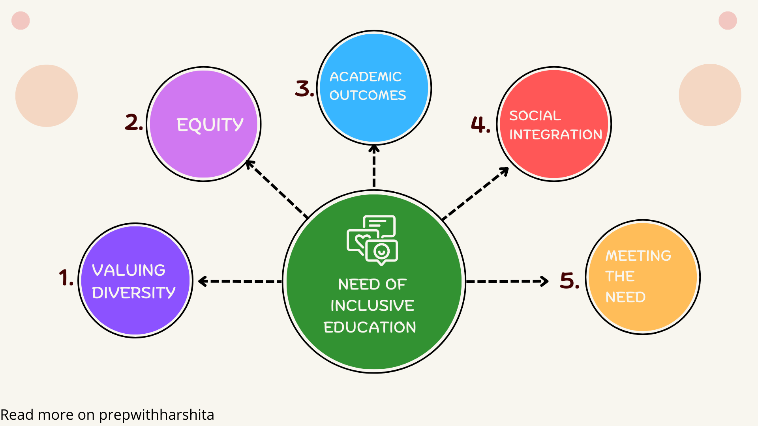


CONCLUSION
FUTURE WORK
Develop plans and resources to ensure educational continuity during crises such as pandemics, natural disasters, or economic downturns.
Utilize educational technology (EdTech) to provide personalized learning experiences and support remote learning where necessary.
Expand access to mental health services in schools to support students facing emotional and psychological challenges.
Develop policies that are flexible and can be adapted based on the changing educational landscape and emerging challenges.

Slide 21
REFERENCES
DATA SOURCES
Education For All in India: Dropout Rates in Schools in India: An Analysis of UDISE+ 2021-22 Data.(https://educationforallinindia.com/dropout-rates-in-schools-in-india)
Open Government Data (OGD) Platform India (https://data.gov.in/catalog/dropout-rate)
Statistica : Average Annual drop-outs in schools in India . (https://www.statista.com/statistics/661218/average-annual-drop-outs-in-schools-india/)
TOOLS AND SOFTWARE USED
Ms Excel: For data cleaning, analysis, and visualization using in-built functions and charts.
Collab: Google Collab for executing python codes for data interpretation.
Matplotlib: For creative visualization and development of Interactive charts.
Seaborn: For visualization
Python:For Data cleaning and manipulation ,synthesizing Regressive Models for prediction.

